Slide 1


Movie parental guide predictive profiling from raw movie script using AI for automated viewability classification
By Sukesh

Slide 2
Contents
1
Problem Overview
2
Data Procurement and Source Details
3
Movie Script Web Scraping – Procedure and Other Details
4
Data EDA Insights & Observations
5
Exploratory Data Analysis Conclusion
6
Next Steps
7
References

Slide 3

Problem Overview
Current Business Problem
Entertainment industry is one of the fastest growing industries in the current age of globalization where content is no longer restricted to regional or language boundaries.
Though there are many positive sides to the growth there few negative implications as well of which one of the major concerns is the influence of Movies on audience, especially children.
Manual approach for rating a movie may seem accurate but it severely suffers from standardization as it can sometime be opinion driven (those there are certain guidelines for rating generation).
Government regulatory bodies like Classification & Ratings Administration (CARA)[1] by Motion Picture Association of America (MPAA)[2], in USA, regulates the content by provided appropriate classification of Parental Guide for Movies aired in USA. The rating provided by these agencies are generally based on potential violence, drug usage, and nudity etc., where a committee of 2-3 people manually watch a movie and provide ratings based on their observation.
Our Solution
In order to address this problem of slow, manual and subjective approach we are proposing a AI driven solution where a deep learning model can be trained to predict intensity of critical factors like violence, foul language, drug/alcohol usage etc., from movie script, which can later be used to provide overall rating for movie view-ability for children. In the current solution proposed we will be rating a movie on the following dimensions sex, violence, profanity, drugs and intense

Slide 4
Data Procurement and Source Details
Movies Metadata
Movies Scripts
Source: Kaggle.com
Source Description: Following is the source description as per Wiki “Kaggle, a subsidiary of Google LLC, is an online community of data scientists and machine learning practitioners. Kaggle allows users to find and publish data sets, explore and build models”
Method Procurement: Direct Download
Data Context:
Data contains selected movies from IMDB along with parental guide information scrapped from web. Data captures other metadata of the movie like Title, Start Year, Run Time etc.,
Source Link: https://www.kaggle.com/datasets/barryhaworth/imdb-parental-guide
Source: IMSDB.com
Source Description: Internet Movie Script Database (IMSDB) website has large collection of movie scripts in HTML format. Which allows users to read and download scripts with no cost.
Method Procurement: Web Scrapping
Data Context:
Data scrapped contains movie scripts in the HTML format. Script can be linked to corresponding metadata using movie title (the id which is used to scrape scripts)
Source Link: https://imsdb.com/

Slide 5


Scraping Movie Script from Internet
Movie tile name from metadata is searched for in imsdb using following link https://imsdb.com/script/<movie tile>
Availability of the movie in IMSDB can be take care using try except block
In case if movie is available script information is extract from the HTML tags
Extracted movie scripts are processed for removing unwanted HTML tags
756 movies scripts have been finally scrapped from IMSDB
Funnel Chart Showing Extraction of Scripts from Metadata till Final Number of Scripts
Extracting Movie Script info
Processing Extracted Script
Yes
39,124
Searching movie title in IMDBS
Title Found?
# of Movies in Metadata
Start
Stop
# Movie Scrapped (from IMSDB)
762
No
# of Valid Scripts (Exc. Blanks)
756
Stop
756
# Script for Model Building

Slide 6
Preprocessing Before Data Exploration
Text normalization
Stopword removal
Special character removal
Root word extraction using lemmatization
Removing words with len <= 2 and >= 15
Word exclusion post observing uni-gram and bi-gram distribution
Exclusion of person names like John, Ben etc.,
Removing script related tags like Cut, Zoom etc.,

Slide 7
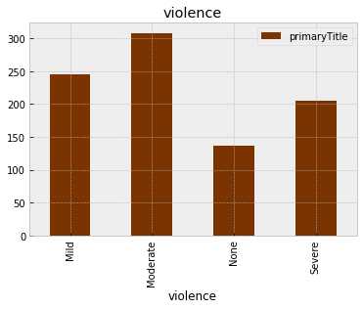
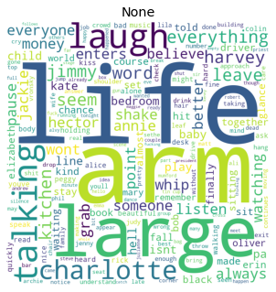
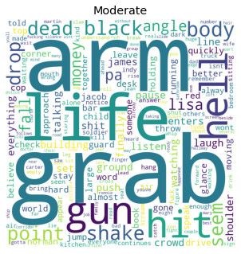
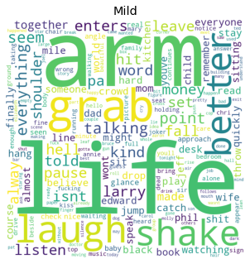
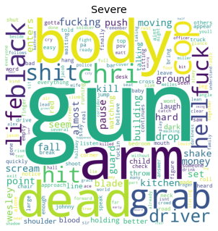
Understanding Parental Guide Ratings - Violence
Observations
Violence has a good distribution of scripts across all four classes
Density of the words showing violence like police station, machine gun, shooting etc., is increasing as we move from violence “None” to “Severe” – Bigram Analysis
Word Cloud
Bi-Gram Distributions

Slide 8
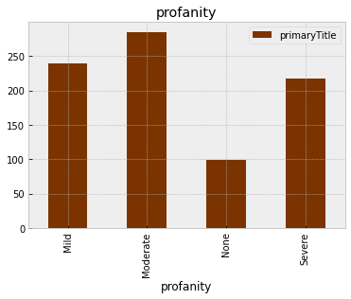
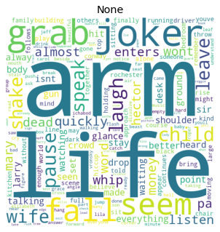
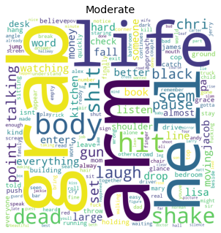
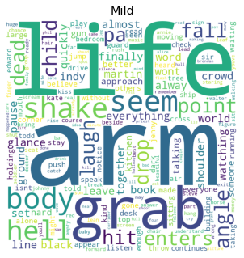
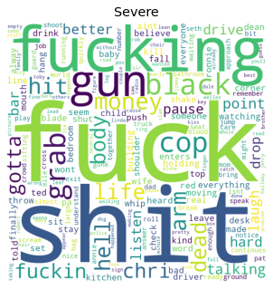
Understanding Parental Guide Ratings - Profanity
Observations
Profanity has a good distribution of scripts across all four classes (Profanity category “None” has relatively lower number of scripts)
Profanity category “None” has no or very less words conveying profanity while category “Severe” has words like f**k, S**t etc., - Observation from Word Cloud
Word Cloud
Bi-Gram Distributions

Slide 9
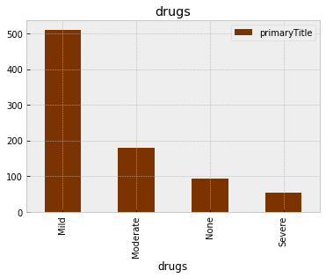
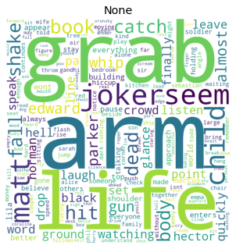
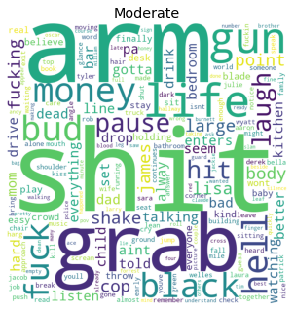
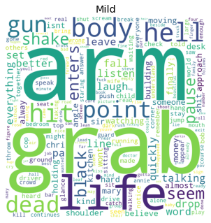
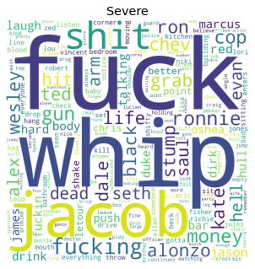
Understanding Parental Guide Ratings - Drugs
Observations
Number of scripts/movies is decreasing as we move from drugs used in the movie from “Mild” to “Severe” and “Mild” category has majority of scripts
This might make classification between “Moderate” and “Severe” a bit difficult due to lower class size
Profanity category “None” has no or very less words conveying profanity while category “Severe” has words like f**k, S**t etc., - Observation from Word Cloud
Word Cloud
Bi-Gram Distributions

Slide 10
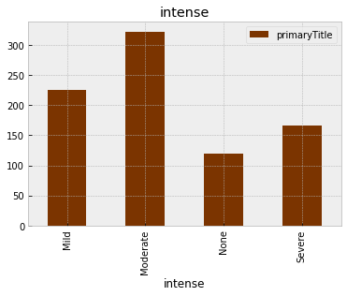
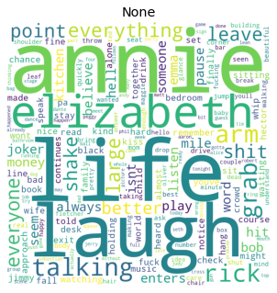
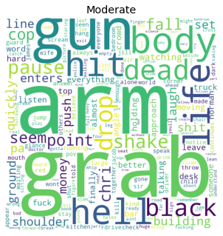
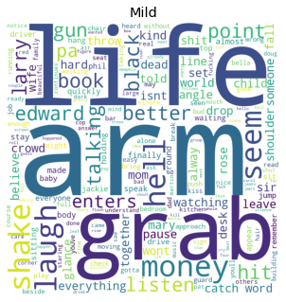
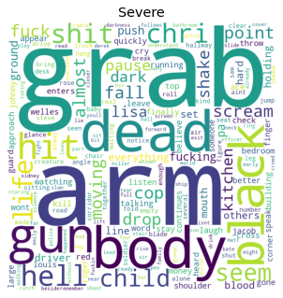
Understanding Parental Guide Ratings - Intense
Observations
Intenseness has a good distribution of scripts across all four classes
Intenseness at a high level has similar word distribution as that of violence
Word Cloud
Bi-Gram Distributions

Slide 11
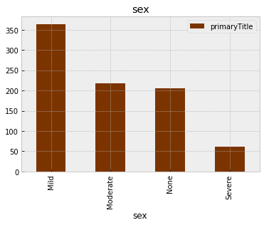
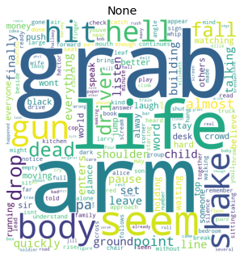
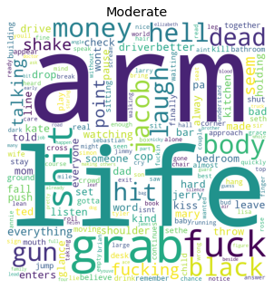
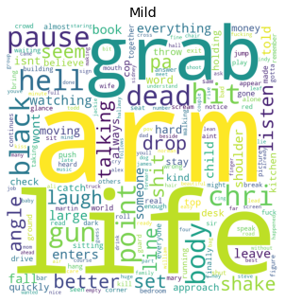
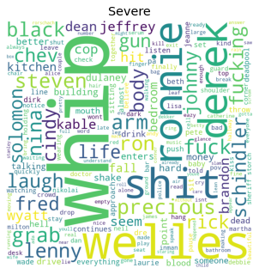
Understanding Parental Guide Ratings - Sex
Observations
Category SEX has a good distribution of scripts across all four classes (Sex category “None” has relatively lower number of scripts)
Word Cloud
Bi-Gram Distributions

Slide 12
Conclusion & Next Steps
Observations
All the five movie parental guide classifications (Violence, Profanity, Intense, Drugs and Sex) has good distribution of scripts across four ratings
Classification of Drugs consumption in movies is a bit exception here as number of scripts/movies is decreasing as we move from drugs used in the movie from “Mild” to “Severe” and “Mild” category has majority of scripts. This might need class balancing for “Moderate” and “Severe” ratings if expected accuracy is not observed
Word distribution/density is change from rating “None” to “Severe” which is a good sign as it helps in easy separation of classes
As lot key words seems to be overlapping between classes its better to use TF-IDF vectors for model train instead of word frequencies
Next Steps
Word vector creation for model development
Model Training and validation

Slide 13
References
Observations
[1] https://www.kaggle.com/datasets/barryhaworth/imdb-parental-guide
[2] https://imsdb.com/
[3] https://www.bbfc.co.uk/about-classification/classification-guidelines
[4] https://www.carafilmratings.com/
[5] https://www.healthychildren.org/English/family-life/Media/Pages/TV-Ratings-A-Guide-for-Parents.aspx
[6] https://www.theschoolrun.com/parents-guide-movie-age-ratings

Slide 14
Thank You

